Slide 1
CITY TECH COLLABORATIVE
We reinvent cities
CUTgroup Overview:
Services and Responsibilities
August 2021

Slide 2
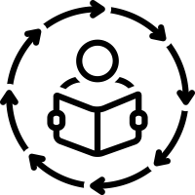


Civic User Testing and CUTgroup
City Tech’s Resident Engagement Strategies Offer Opportunities for Civic Input and Inclusivity Throughout Product Development
OVERVIEW
BENEFITS
City Tech’s resident engagement program invites residents to contribute feedback to improve design and deployment of early-stage product, program, and initiative development. Our program utilizes our Civic User Testing group (CUTgroup), a diverse group of 1600+ residents from across Chicago.
We engage diverse individuals and are inclusive of all backgrounds, experiences, and digital skill-levels. We can test on a variety of devices and browsers to meet resident and partner needs.
Inclusive Testing Methods
We collaboratively design engagements to meet partners’ goals and provide end-to-end planning, support, and execution of usability testing.
SERVICES AND TIMELINE
SERVICES
ENGAGEMENT SCOPING
TESTING TIMELINE
In early stages of a project, civic user testing can be used to gather user needs and requirements and better understand existing gaps
Collaborative Design & Full-Service Support
TEST DESIGN
RECRUTMENT
Further into a project, users can provide feedback for the product or solution through early development testing or later beta testing
We report insights from user’s feedback and deliver actionable recommendations to our partners to determine the best next steps to make their technologies accessible and user-friendly
TEST EXECUTION
Resident engagement can also be utilized to help socialize and deploy a product/solution/service
ANALYSIS & REPORTING
Analysis & Recommendations

Slide 3
Civic User Testing Process AND Timeline
All Steps and Suggested Durations are Approximations Based on Past City Tech Engagements and Can Be Refined for Individual Projects
Scoping
(1-3 wks)
Work with client to understand testing opportunities and outline collaboration
Planning and Test Design
(2-4 wks)
Define test and recruiting goals; Finalize testing plan and questions
Recruitment
(2-3 wks)
Recruit and schedule testers; Recruit and train proctors (if applicable)
Civic User Testing Engagement (2-4mo)
Test Execution
(TBD, based on scope)
Turn scope into action: procure space and technology, set up intake and consent forms, run test, record data, compensate testers
Analysis and Reporting
(2-3 weeks)
Analyze the testing data and brief client team on actionable recommendations

Slide 4
Proposed CUTgroup Service Models
Phase | Deliverable | Full Service Engagement | Recruitment Only
Scoping | Scope of work, including narrowed test opportunity | ✓
Planning and Test Design | Collaboratively defined project and recruiting goals | ✓ | ✓
 | Screening questions for recruitment | ✓ | ✓
 | Iterative test scenarios and a test plan | ✓
Recruitment | Pool of CUTgroup participants who meet target user criteria | ✓ | ✓
 | Pool of trained proctors (if required) | ✓ | ✓
Test Execution | Procurement of space and test technology, if needed | ✓
 | Facilitation and documentation of test sessions | ✓
Analysis and Reporting | High-level user feedback summary | ✓
 | Briefing of actional recommendations | ✓
 | Access to full testing data, scrubbed of any identifying information to ensure compliance with privacy policy (if requested) | ✓
Project Management and Communications | Project management services and updates to stakeholders throughout project | ✓
 | Participation in or support with relevant communications opportunities related to the project | ✓ | ✓
Outside opportunities that are not run through CUTgroup but still fit the mission of the program
can be potentially be passed on to the group but the CUTgroup team would only be responsible for sharing the opportunity

Slide 5
Example Test activities and responsibilities
Phase | Activity | Execution Lead* | Community Lead* | Funder* | Client*
Scoping | Identify test opportunity and develop scope of work | X |  | X | X
Planning and Test Design | Align on project goals and tester profiles | X | X |  | X
 | Develop screening questions for recruitment | X | X |  | X
 | Finalize client testing material and share access with testing team | X |  |  | X
 | Outline test scenarios and develop test plan | X | X |  | X
Recruitment | Recruitment of CUTgroup participants who meet target user criteria | X | X
 | Recruitment and training of proctors | X | X
Test Execution | Procure space and test technology, if needed | X
 | Execute, facilitate, and document test sessions | X | X
Analysis and Reporting | Analyze full test results and develop user feedback summary and key recommendations | X
 | Develop scrubbed, shareable version of project data | X
 | Brief project stakeholders on actionable recommendations | X | X | X | X
Project Management and Communications | Provide project management services and updates to stakeholders, potentially lead communications | X
*Funder, Execution Lead, and Community Lead can be within the same organizations or from unique organizations. Client is often a different organization that is asking for services, but if it’s an internal project, could also be within the same organization
X: Lead X: Participant/Consulted

Slide 6
Thank YOu

Slide 7
Appendix: Chicago CUTgroup Case Studies

Slide 8
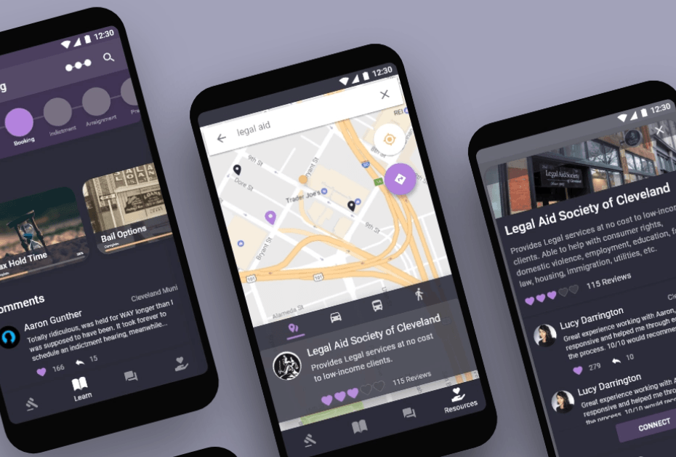


Case Study | unBAil APP
CUTgroup Test on unBail App Wireframes
Goal unBail created an app to help defendants in both municipal and county court systems facing felony or misdemeanor charges navigate their pre-trial information. The app is also meant to serve family members and friends of a defendant who is being held in jail while awaiting trial.
Engagement We designed and led a round of remote, moderated wireframe/usability tests to ensure that the app was accessible, user friendly, and contained the information that the users were looking for. The majority of the testers had experience with thee municipal or county systems through their own charges or through family and friends.
Outcome We provided our partners a set of recommended priority issues to fix. The unBail team has already incorporated the feedback from the user test into the app prototype, and is now preparing to release a request for proposal to developers in order to translate the prototype into a cross-platform mobile app. The team may also conduct additional usability testing for a beta version of the unBail app with end users.
“CUTgroup provided us our first opportunity to get our product in front of potential users. They conducted a thorough and precise user test that provided us with detailed feedback. The user test significantly increased our organizational capacity, but more importantly, affirmed that we are moving in the right direction to best serve our users.”
- Cait Kennedy, Executive Director and Co-Founder of unBail
CONFIDENTIAL |NOT FOR DISTRIBUTION
8

Slide 9
Case Study | Ventra App
CUTgroup Test on Beta Ventra App
Goal During the development of the Ventra smartphone app, the Chicago Transit Authority (CTA), Pace, and Metra engaged the CUTgroup to ensure they were building a user-friendly, accessible app.
Engagement We designed and led two rounds of usability testing– remote/unmoderated & in-person/moderated– to see if the app would be accessible and usable to a number of different Chicago public transit riders. Our participants were excited to contribute to the app development process that would impact a project that would eventually be rolled out to millions of people.
Outcome We provided our partners a set of recommended priority issues to fix. Once those issues were resolved, the app was rolled to an even larger beta group and then launched in January 2016. In two years, the Ventra app has been downloaded over 2 million times.
“Our work with the CUTgroup has proved to be an incredibly valuable experience as part of our test plan for the Ventra app—both through the thoughtful feedback we received via the remote test and in affording us an opportunity to sit down face-to-face with a diverse range of riders of CTA, Metra and Pace and learn about users’ experiences together combining an open dialogue and structured testing.” – Tony Coppoletta, CTA
CONFIDENTIAL |NOT FOR DISTRIBUTION
9

Slide 10




Case Study | Cook County Website
CUTgroup Test on Wireframes of CookCountyIL.gov
Goal In 2015, the Cook County Bureau of Technology (BoT) embarked on a redesign of the Cook County website. BoT staff wanted to understand if their new designs were user-friendly before they began development.
Engagement That summer, we designed and conducted A/B moderated usability tests with 20 Cook County residents on low-fidelity wireframes of the homepage to see how users would navigate to find information or services. A/B testing allowed us to test different options for search and how information was organized.
Outcome We provided Cook County BoT with a set of recommendations based on the effectiveness of each wireframe on specific navigation tasks. The implemented design, which is the current website, executed on their recommendations by incorporating elements of each wireframe.
CONFIDENTIAL |NOT FOR DISTRIBUTION
10

Slide 11
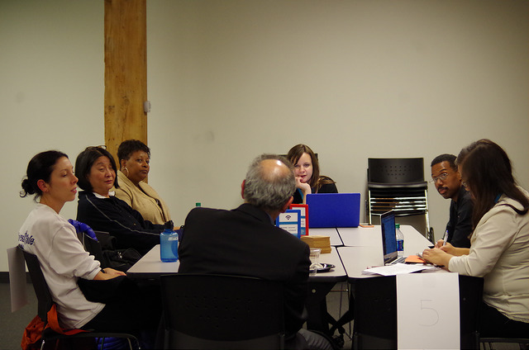

Case Study | Chicago’s Digital SkillS
CUTgroup Test to Inform Connect Chicago
Goal Connect Chicago aligns citywide efforts to make Chicago the most skilled, most connected, most dynamic digital city in America. The program was interested in gathering qualitative information on how Chicago residents think about and deal with digital technology, specifically to understand if residents know about the resources in their own neighborhood, how they prioritize gaining new skills that center around technology, and how to better connect residents to technology resources in their neighborhood.
Engagement We conducted three in-person focus group, moderated by a City Tech facilitator. Before the focus groups, all testers completed a pre-survey questionnaire about the technology tools that they used. This helped us capture individuals’ responses prior and avoid putting users on the spot during the focus groups.
Outcome Tester responses helped to shape the Connect Chicago program and inform the website
CONFIDENTIAL |NOT FOR DISTRIBUTION
11

